Slide 1
Spring AOP Example – Pointcut , Advisor
Advice
Indicate the action to take either before or after the method execution.
Pointcut
Indicate which method should be intercept, by method name or regular expression pattern.
Advisor
Group ‘Advice’ and ‘Pointcut’ into a single unit, and pass it to a proxy factory object.
Class A
Method1
Method2
Method3

Slide 2
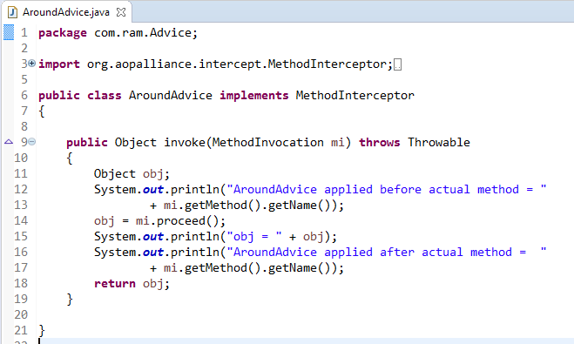
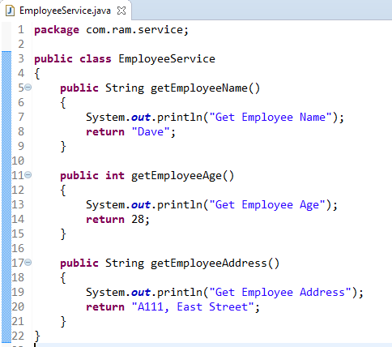
How to apply AroundAdvice only for the method getEmployeeAge() and don’t apply for other methods?
We can match the method via following two ways :
Name match
Regular repression match

Slide 3
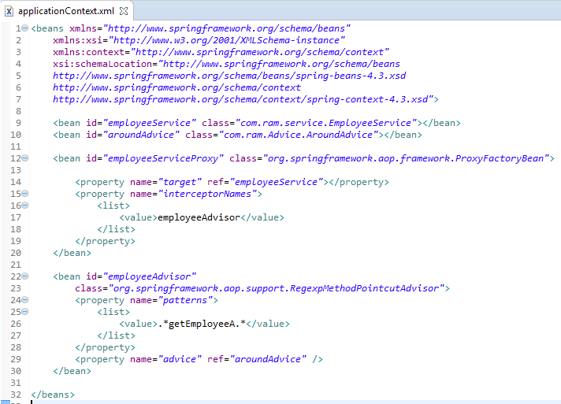
We can also match the method’s name by using regular expression pointcut – RegexpMethodPointcutAdvisor.
Now, it intercepts the method which has words ‘getEmployeeA’ within the method name. In practice, we can use it to manage DAO layer, where you can declare “.*DAO.*” to intercept all your DAO classes to support transaction.

Slide 4
